Slide 1
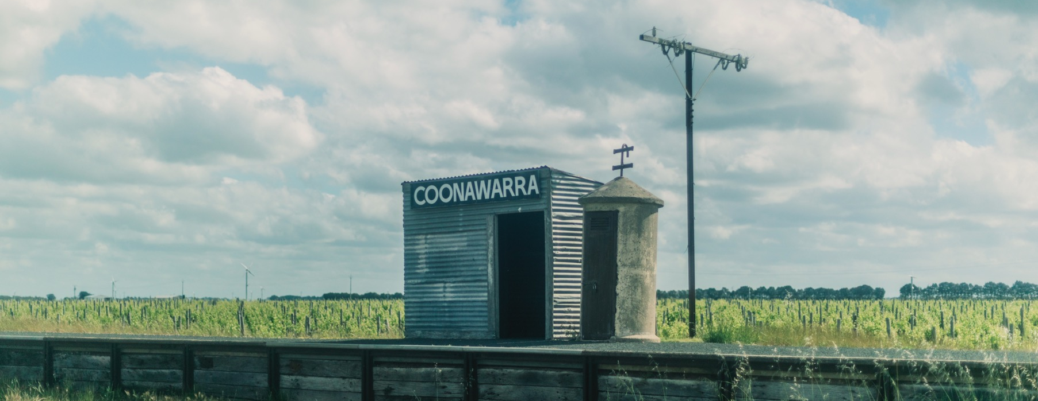
COONAWARRA

Slide 2
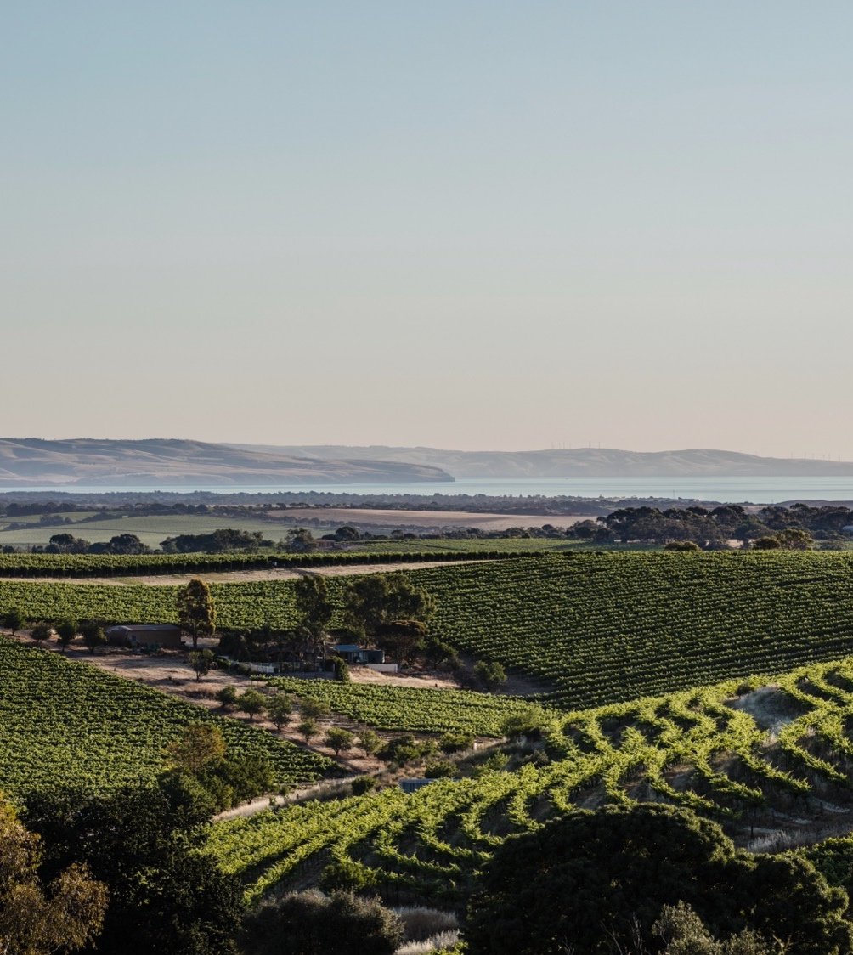

Crafted from grapes grown under vast and diverse climates, across landscapes millions of years in the making, every glass of Australian wine tells a story.
Like those who came before us, our modern growers and makers continue to be passionate, resilient and creative; constantly driven to explore new ways to perfect old techniques. Our community is connected by a mutual respect and shared love of crafting exceptional wine, while protecting the natural wonders for future generations to enjoy. Applying modern thinking to our ancient lands, we take playful experimentation very, very seriously.
So, if you’re looking for the taste of adventure, let Australian wine be your compass. Because in every bottle of Australian wine, you’ll experience the wonders of Australia – a reminder of the adventure and diversity that defines our culture and our land.

Slide 3
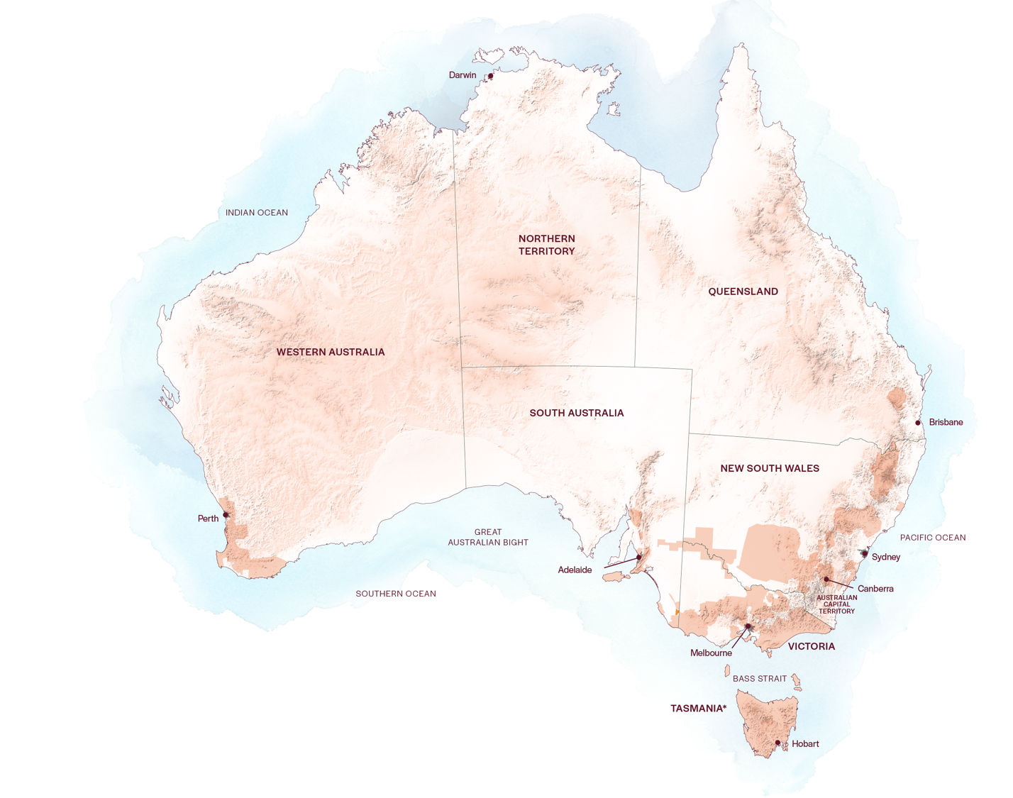
AUSTRALIA
COONAWARRA

Slide 4
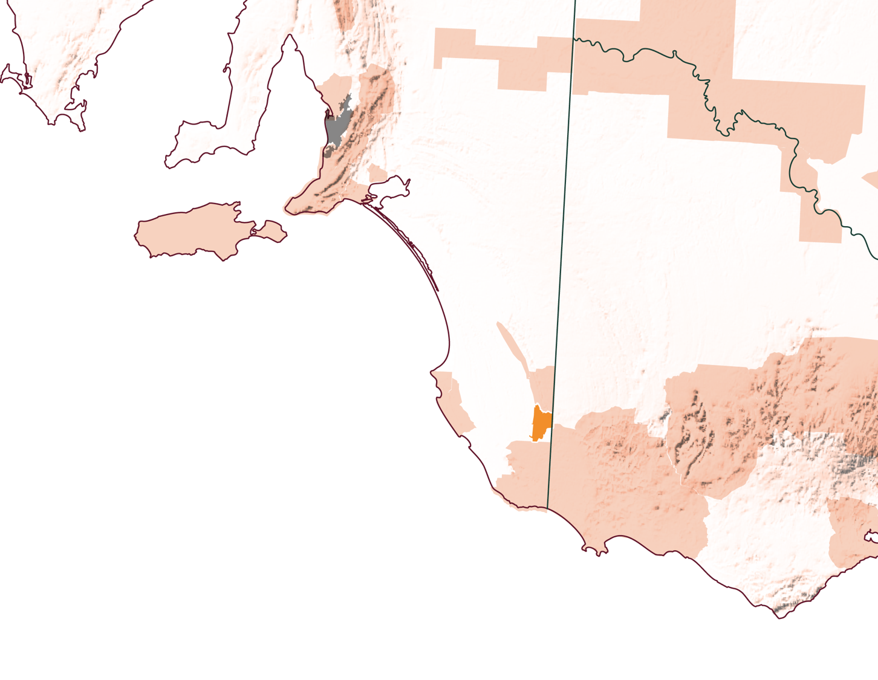
SOUTH
AUSTRALIA
COONAWARRA

Slide 5
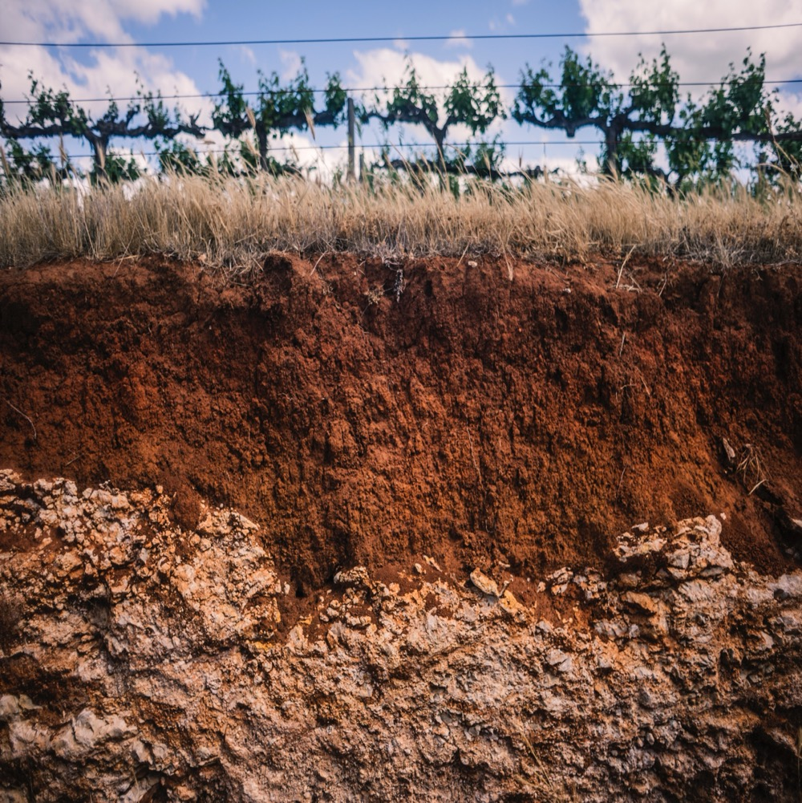
COONAWARRA
TAKE THE TIME
Coonawarra is one of Australia’s most internationally celebrated wine regions, famous for its vivid red soil and world-class red wines.
Cooler, maritime-influenced
climate and unique terra rossa soil
Long wine history
World-class Cabernet Sauvignon and collectible, age-worthy fine wines
Evolution in the vineyard and winery have led to more elegant, vibrant wine styles

Slide 6
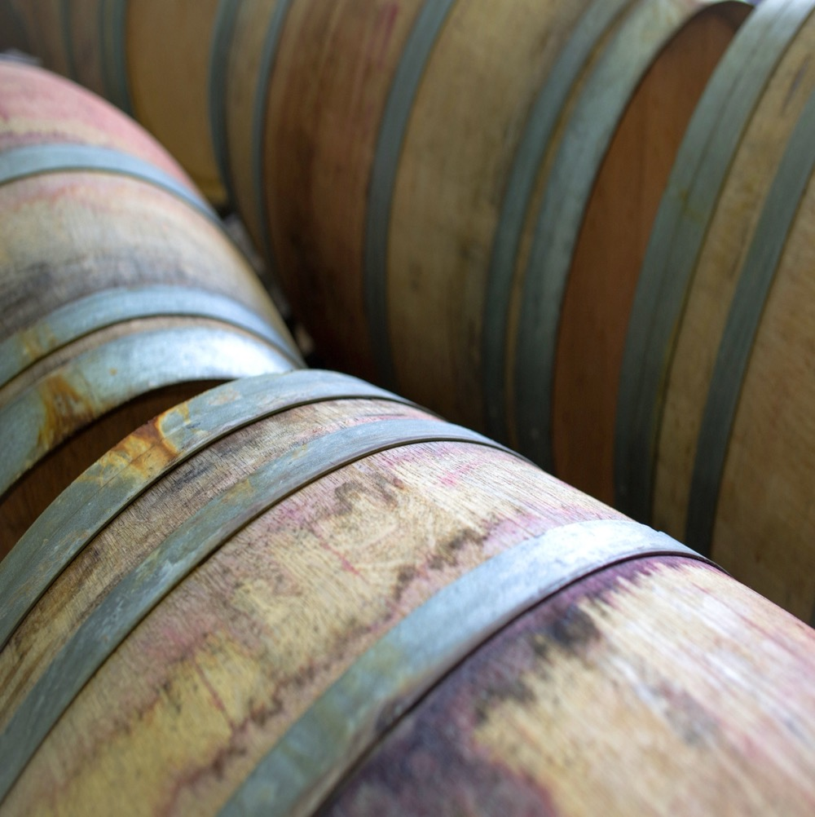
TODAY WE’LL COVER
The history of Coonawarra
Geography, climate and soil
Viticulture
Winemaking
Prominent varieties

Slide 7
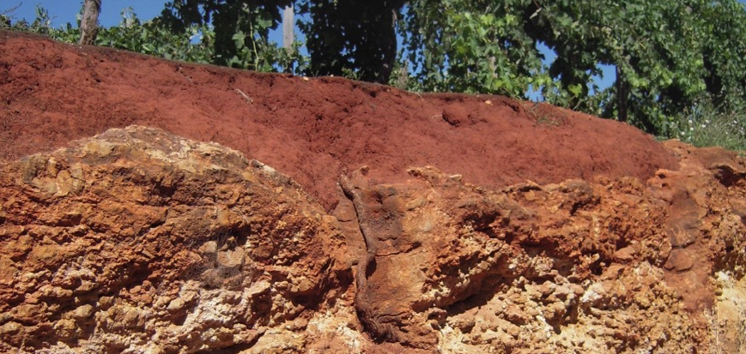
Mid 1800s
THE HISTORY OF COONAWARRA
WINE HERITAGE REVIVAL AND SOME CONTROVERSY
Late 1800s
1901
European settlers establish sheep farms and fruit
orchards. Scottish‑born
gardener William Wilson chooses the red terra rossa soil and advises fellow Scotsman John Riddoch to do the same.
John Riddoch plants the region’s first grapevines: Cabernet Sauvignon and Shiraz, plus
some small plots of Pinot Noir, Malbec and Pedro Ximenez.
Due to recent economic depression, the industry struggles for the next 50 years.

Slide 8
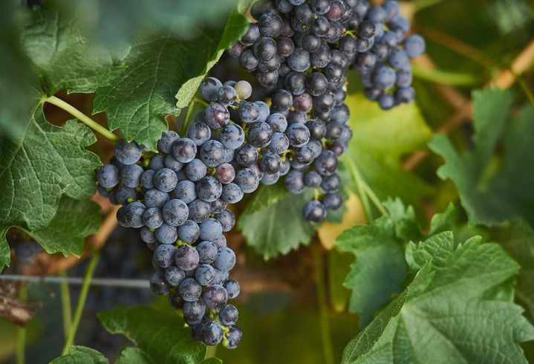
1960s – 1980s
Today
Australia experiences a global wine boom and Coonawarra locals and farmers diversify into grape growing. The region’s boundaries are extended despite protests by some growers on the existing area of terra rossa.
Coonawarra has retained its crown as a top Cabernet Sauvignon region. But there’s more here than meets the eye, with respected makers crafting various modern styles and a new generation enlivening the region.
1951
1990s – 2000s
The region’s revival begins
when David Wynn and his
wine merchant father, Samuel, buy Riddoch’s rundown property, establishing the now-famous Wynns Coonawarra Estate.
Coonawarra flourishes, becoming one of Australia's leading Cabernet Sauvignon regions. Big producers invest and local wineries grow.

Slide 9
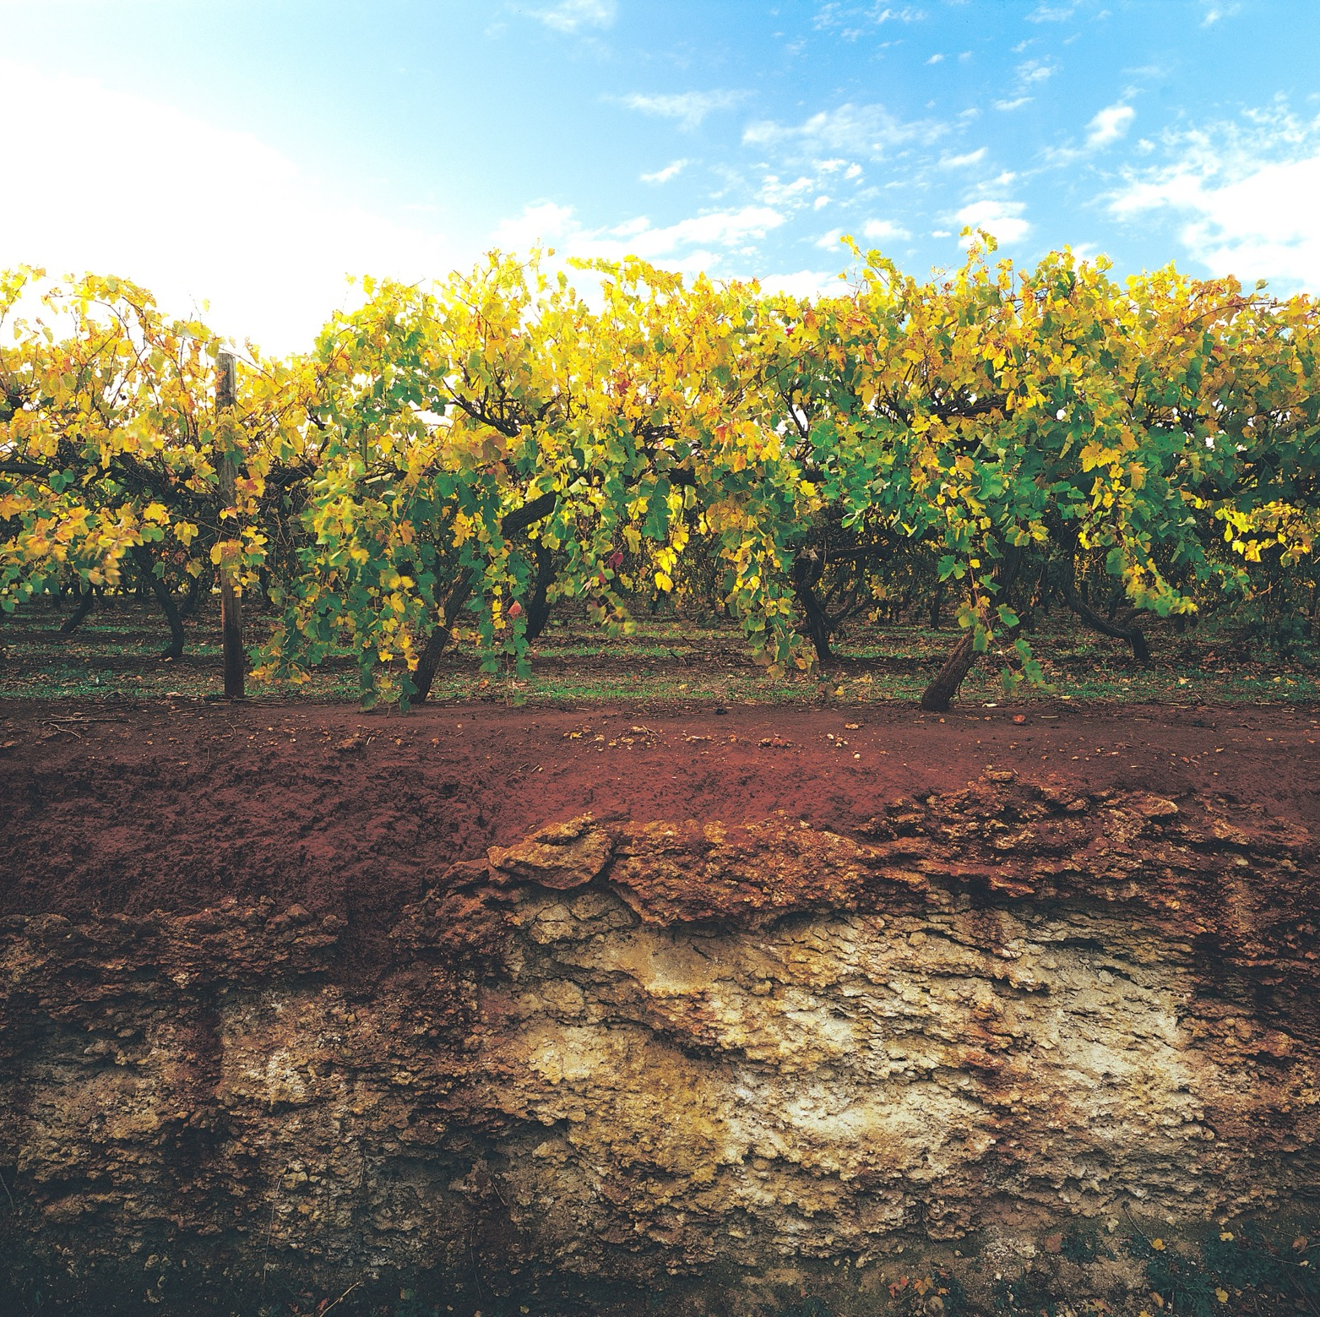
DID YOU KNOW?
Coonawarra’s strip of terra rossa soil caused controversy during the defining of the region’s legal boundaries in the ’90s. Some growers wanted to widen the boundary while those inside the terra rossa zone did not. After nearly 10 years of debate, the boundaries were expanded.

Slide 10
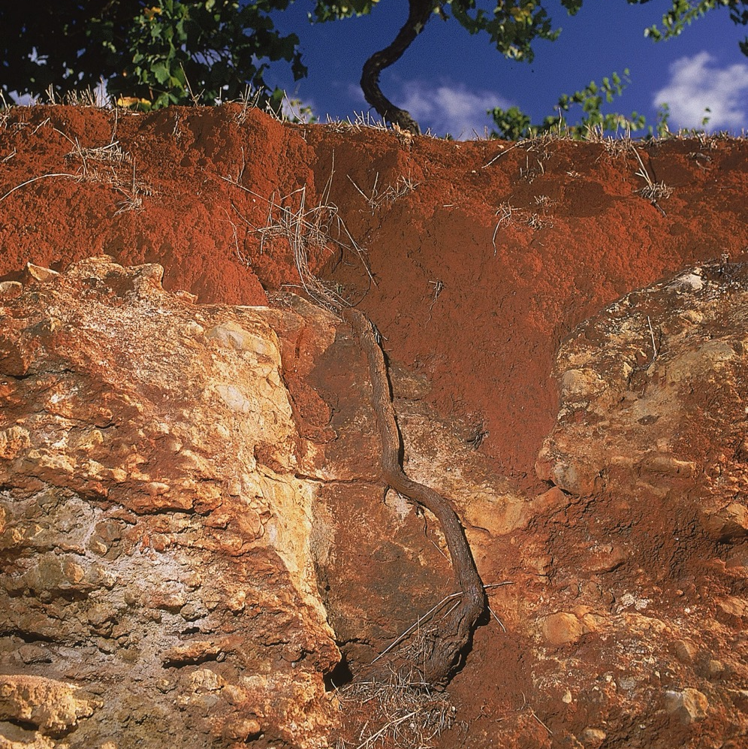
GEOGRAPHY, CLIMATE AND SOIL
AUSTRALIA’S RED CARPET REGION
On the Limestone Coast, around four hours’ drive from Adelaide and five from Melbourne
A picturesque region of immaculate vine rows, ancient river red gum trees and red soil
More moderate climate than many South Australian wine regions
Maritime-influenced climate and limestone-based soils provide ideal grape-growing conditions

Slide 11
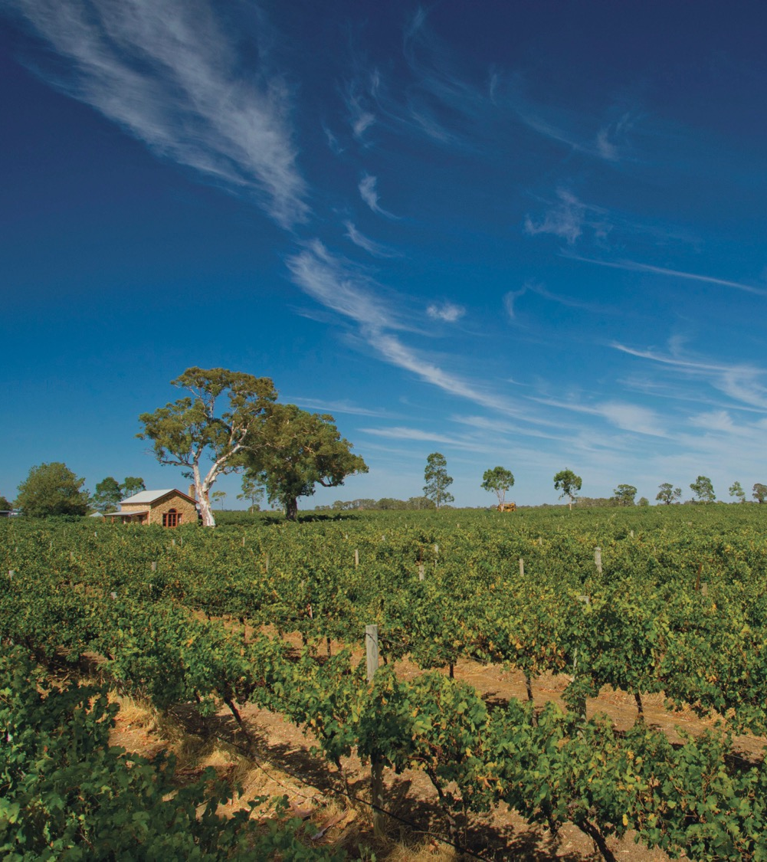
CLIMATE
ALTITUDE
MARITIME
VERY HIGH
1000m +
(>3,280ft +)
WITH COOL-CLIMATE CHARACTERISTICS
HIGH
750–999m
(2,460–3,279ft)
MEDIUM
500–749m
(1,640–2,459ft)
COONAWARRA
50–110M (164 - 236FT)
LOW
0–499m
(0–1,639ft)

Slide 12
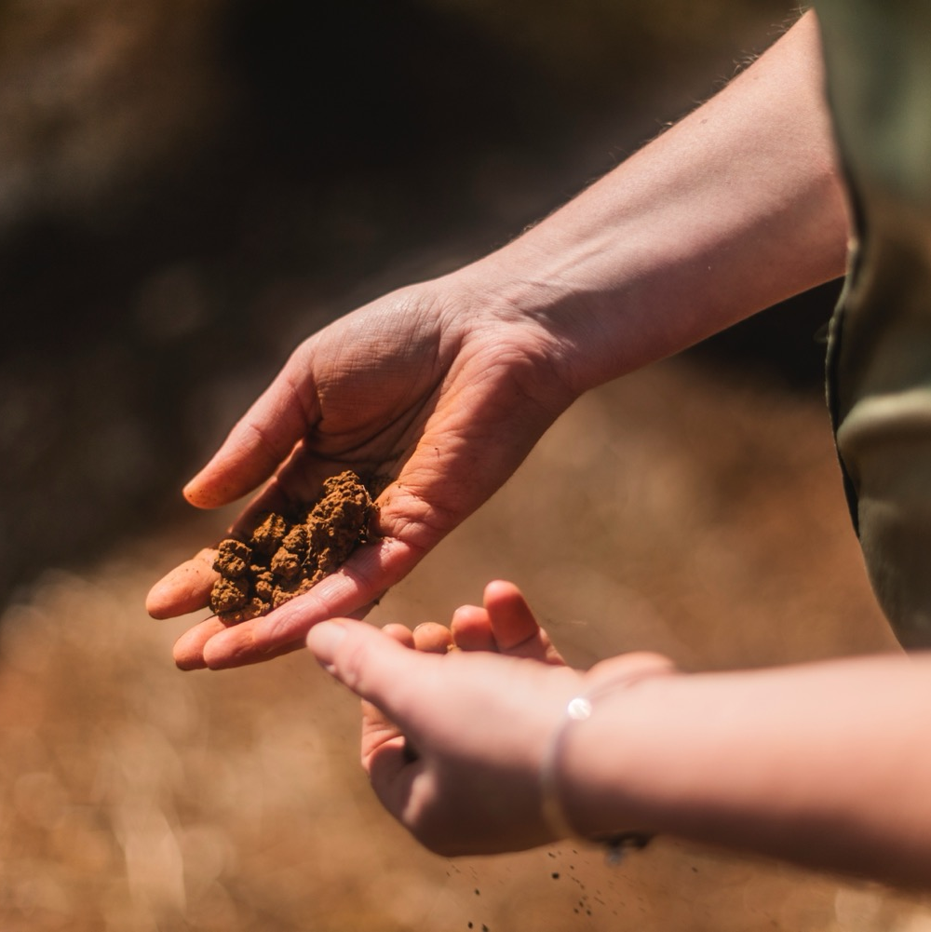
SOIL
Coonawarra is famous for its strip of terra rossa (Italian for ‘red soil’). It sits on top of a ridge of limestone above an ancient reservoir of pure water – ideal for growing world-class grapes. Other soils include black and brown rendzina clays and sandy loams.

Slide 13
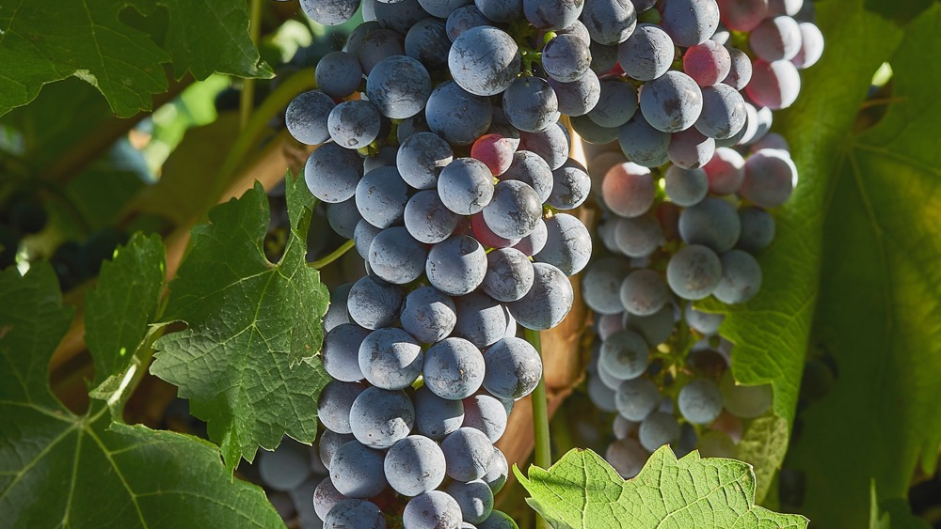
VITICULTURE AND WINEMAKING
COONAWARRA

Slide 14
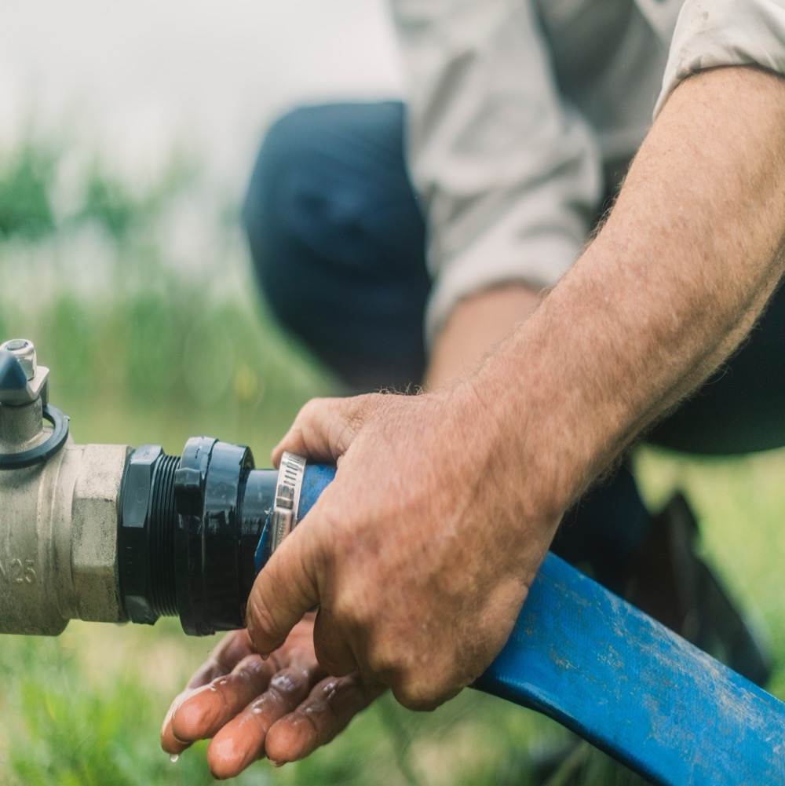
GRAPE GROWING
EVOLUTION AND INNOVATION
Region benefits from a mix
of experienced viticulturists
and winemakers, and relative newcomers
Past decade has seen numerous innovations in the vineyard
New trellis practices, improved water management and
greater focus on sustainability
Harvest: Early February to April

Slide 15
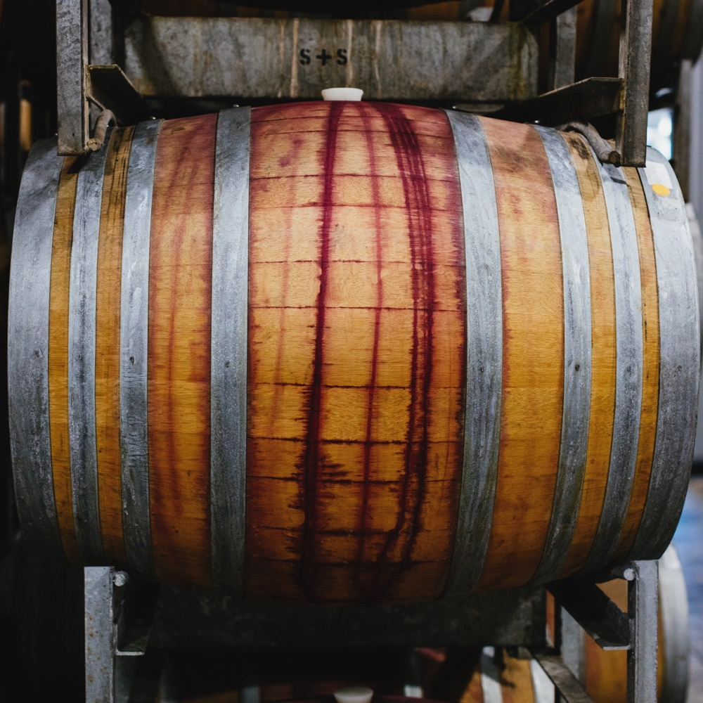
WINEMAKING:
WHERE QUALITY TAKES TIME
Closer collaboration between viticulturists and winemakers
More refined use of oak for ageing red wines
Blending for balance, complexity, intensity and length

Slide 16
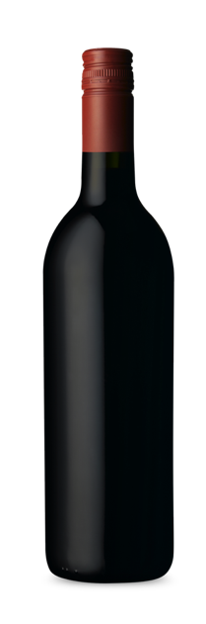
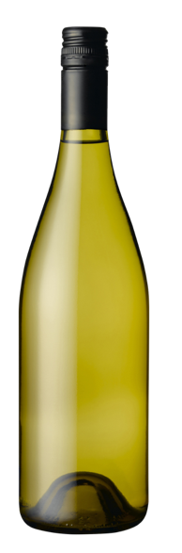
COONAWARRA
TOP 5 VARIETIES
CABERNET
SAVIGNON
SHIRAZ
MERLOT
SAUVIGNON
BLANC
CHARDONNAY
CABERNET
SAUVIGNON
55%
SHIRAZ
24%
MERLOT
7%
CHARDONNAY
6%
SAUVIGNON BLANC
3%

Slide 17
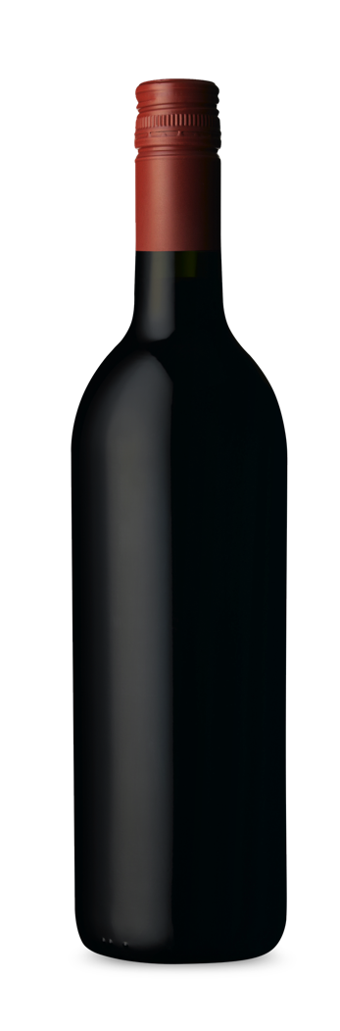
COONAWARRA
CABERNET SAUVIGNON
STAR OF THE REGION
RENOWNED FOR ITS AGEING ABILITY
MODERN STYLE IS ELEGANT AND DRINKABLE WHEN YOUNG
MORE THAN
1/2
OF TOTAL
ANNUAL
CRUSH
CABERNET SAUVIGNON
TYPICAL PRIMARY
FLAVOURS
Black cherry
Blackcurrant
Cassis
Dried mint
Eucalyptus
Capsicum (bell pepper)
TYPICAL AGED
FLAVOURS
Cedar
Tobacco
Earth
OAK FLAVOURS WITH NOTES OF CEDAR, TOAST AND CHARRED WOOD

Slide 18
CABERNET SAUVIGNON characteristics
COLOUR
Cabernet Sauvignon
Light
Medium
Full
BODY
Dry
Medium dry
Sweet
SWEETNESS
CABERNET SAUVIGNON
Low
Medium
High
OAK
TANNIN
ACIDITY
8%
13.5% – 15.5%
17%
ALCOHOL

Slide 19

COONAWARRA
SHIRAZ
LONG
HISTORY IN COONAWARRA
ELEGANT COOLER-CLIMATE STYLE
SOMETIMES BLENDED WITH CABERNET SAUVIGNON OR MERLOT
OAK FLAVOURS WITH NOTES OF VANILLA, CEDAR, SMOKE AND COCONUT
SHIRAZ
TYPICAL PRIMARY
FLAVOURS
Pepper
Raspberry
Blackberry
Plum
Spice
Mint
TYPICAL AGED
FLAVOURS
Cedar
Tobacco
Leather
MORE THAN
1/4
OF TOTAL
ANNUAL
CRUSH

Slide 20
SHIRAZ characteristics
COLOUR
Shiraz
Light
Medium
Full
BODY
Dry
Medium dry
Sweet
SWEETNESS
Low
Medium
High
SHIRAZ
OAK
TANNIN
ACIDITY
8%
17%
13.5% – 15.5%
ALCOHOL

Slide 21
COONAWARRA
MERLOT
COMMONLY BLENDED WITH CABERNET SAUVIGNON
OR SHIRAZ
INCREASINGLY SUCCESSFUL VARIETY
PRODUCES STANDOUT SINGLE-VARIETY WINES
MERLOT
TYPICAL PRIMARY
FLAVOURS
Plum
Blueberry
Cassis
Fruitcake
TYPICAL AGED
FLAVOURS
Tobacco
Chocolate
Savoury
PLANTED MORE RECENTLY

Slide 22
MERLOT characteristics
COLOUR
Merlot
Light
Medium
Full
BODY
Dry
Medium dry
Sweet
SWEETNESS
Low
Medium
High
OAK
MERLOT
TANNIN
ACIDITY
8%
17%
13.5% – 15.5%
ALCOHOL

Slide 23
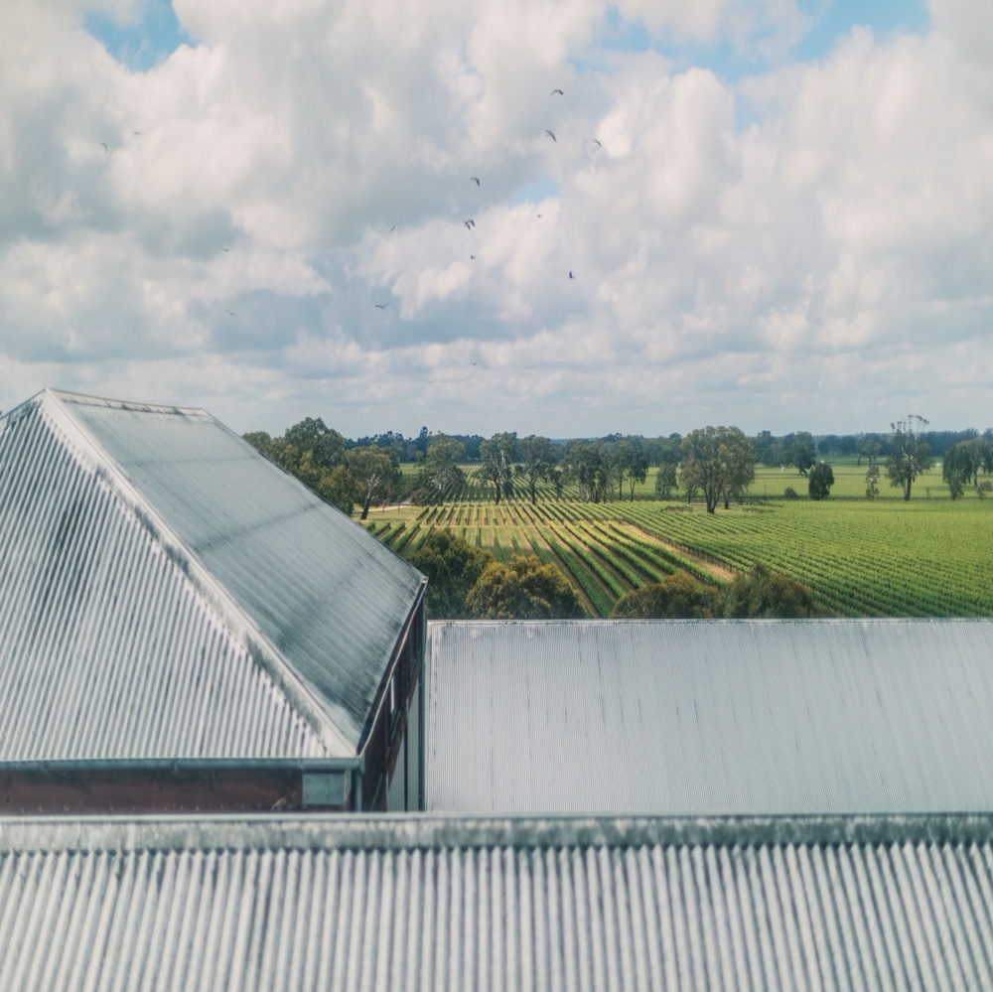
COONAWARRA
With its famous red soil, world‑class wines and forward‑looking community of growers and makers, the red heart of Australian wine is beating stronger than ever.

Slide 24
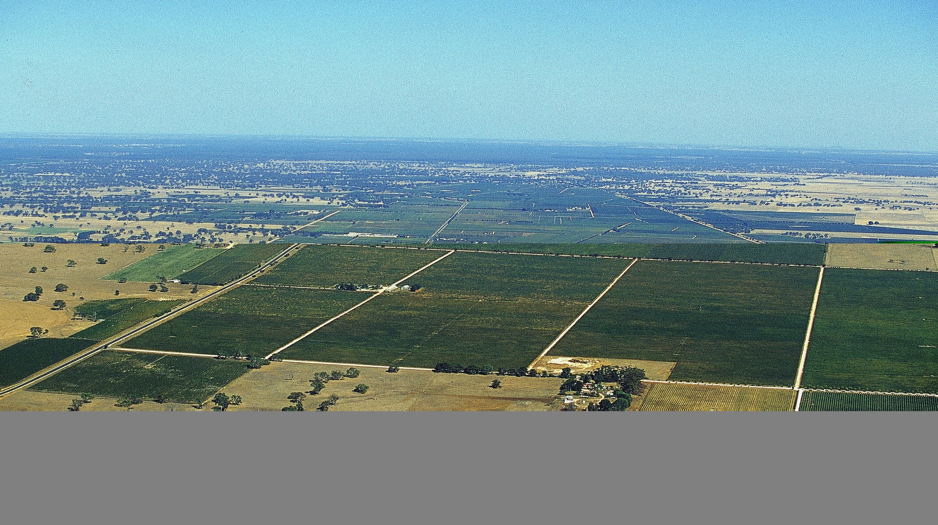
THANK YOU

