Slide 1
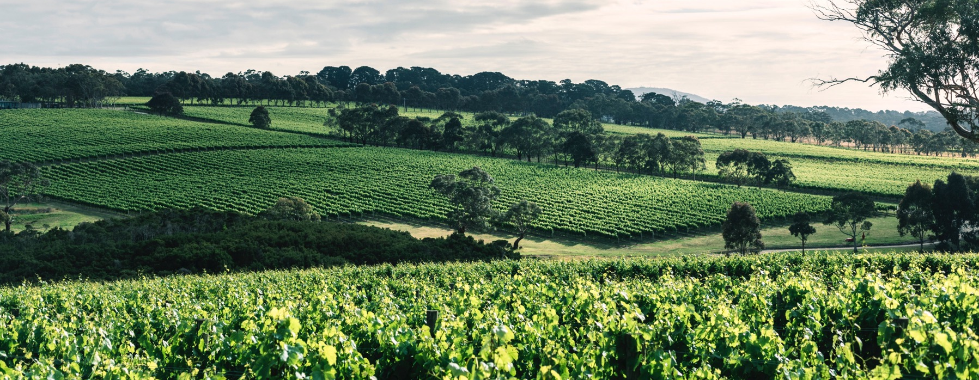
MORNINGTON PENINSULA

Slide 2
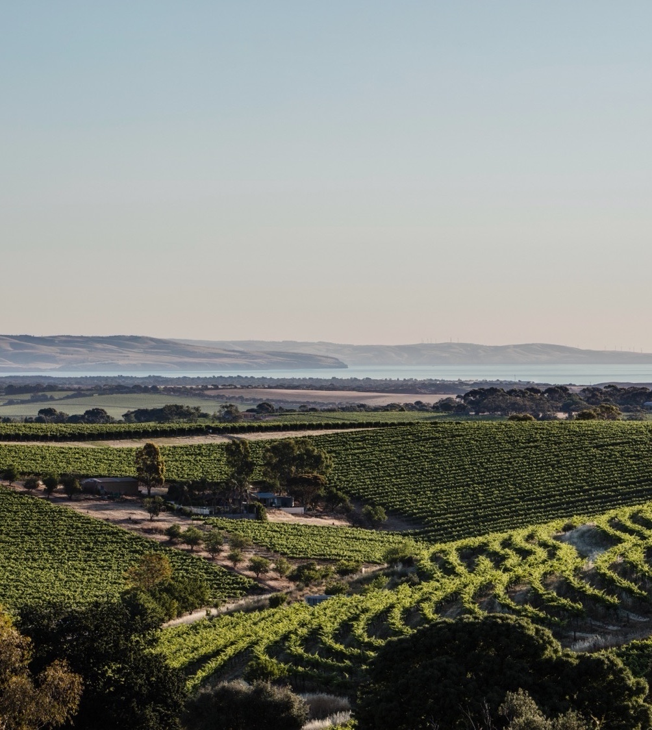

Crafted from grapes grown under vast and diverse climates, across landscapes millions of years in the making, every glass of Australian wine tells a story.
Like those who came before us, our modern growers and makers continue to be passionate, resilient and creative; constantly driven to explore new ways to perfect old techniques. Our community is connected by a mutual respect and shared love of crafting exceptional wine, while protecting the natural wonders for future generations to enjoy. Applying modern thinking to our ancient lands, we take playful experimentation very, very seriously.
So, if you’re looking for the taste of adventure, let Australian wine be your compass. Because in every bottle of Australian wine, you’ll experience the wonders of Australia – a reminder of the adventure and diversity that defines our culture and our land.

Slide 3
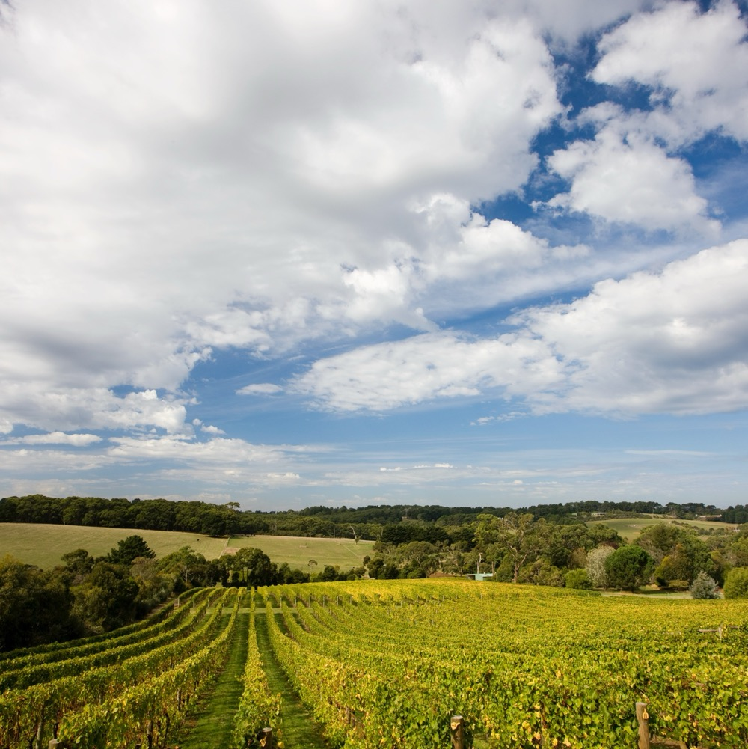
MORNINGTON PENINSULA
A STAR ON THE RISE
The Mornington Peninsula is a small seaside region making waves with its elegant cool-climate wines.
Diverse maritime climate and soils create
an array of microsites
Around 200 small-scale vineyards and
boutique producers
World-class Pinot Noir plus top-quality Chardonnay and Pinot Gris/Grigio
Popular tourist destination and foodie hotspot

Slide 4
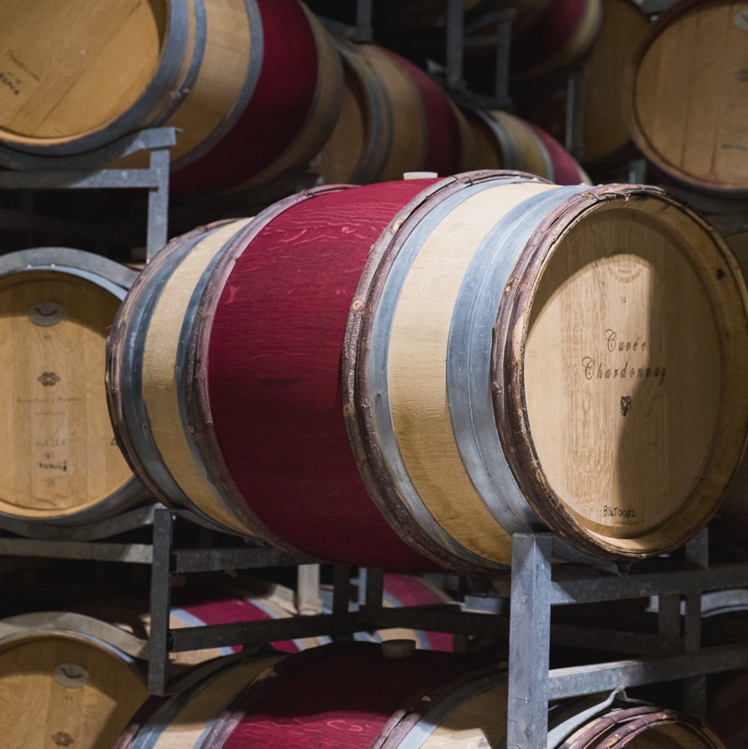
TODAY WE’LL COVER
The history of Mornington Peninsula
Geography, climate and soil
Viticulture
Winemaking
Prominent varieties

Slide 5
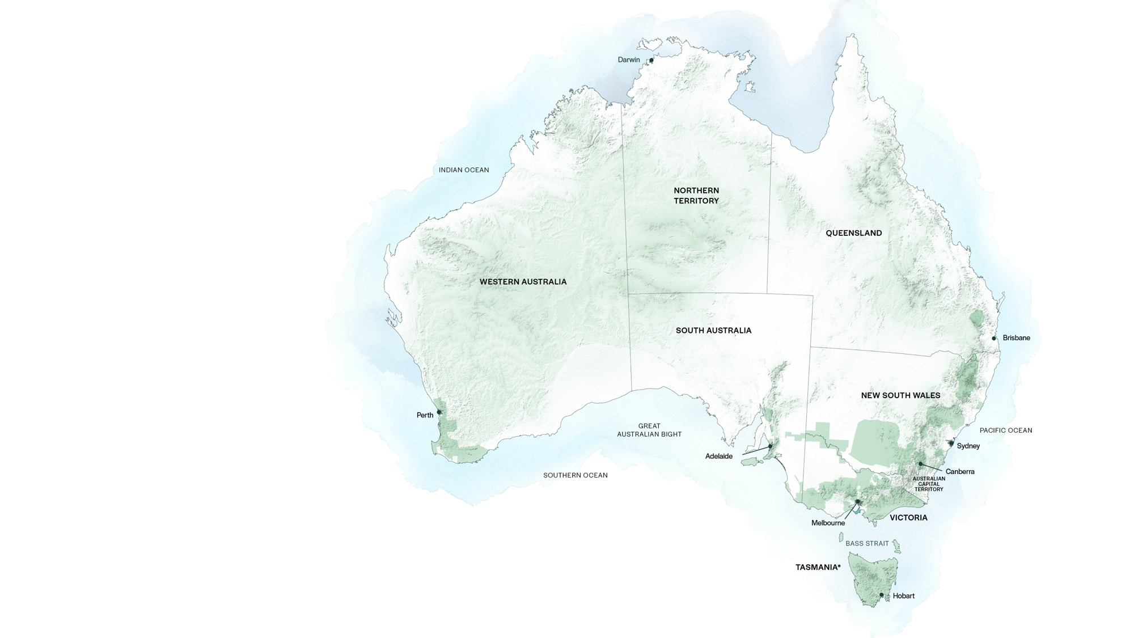
AUSTRALIA
MORNINGTON PENINSULA

Slide 6
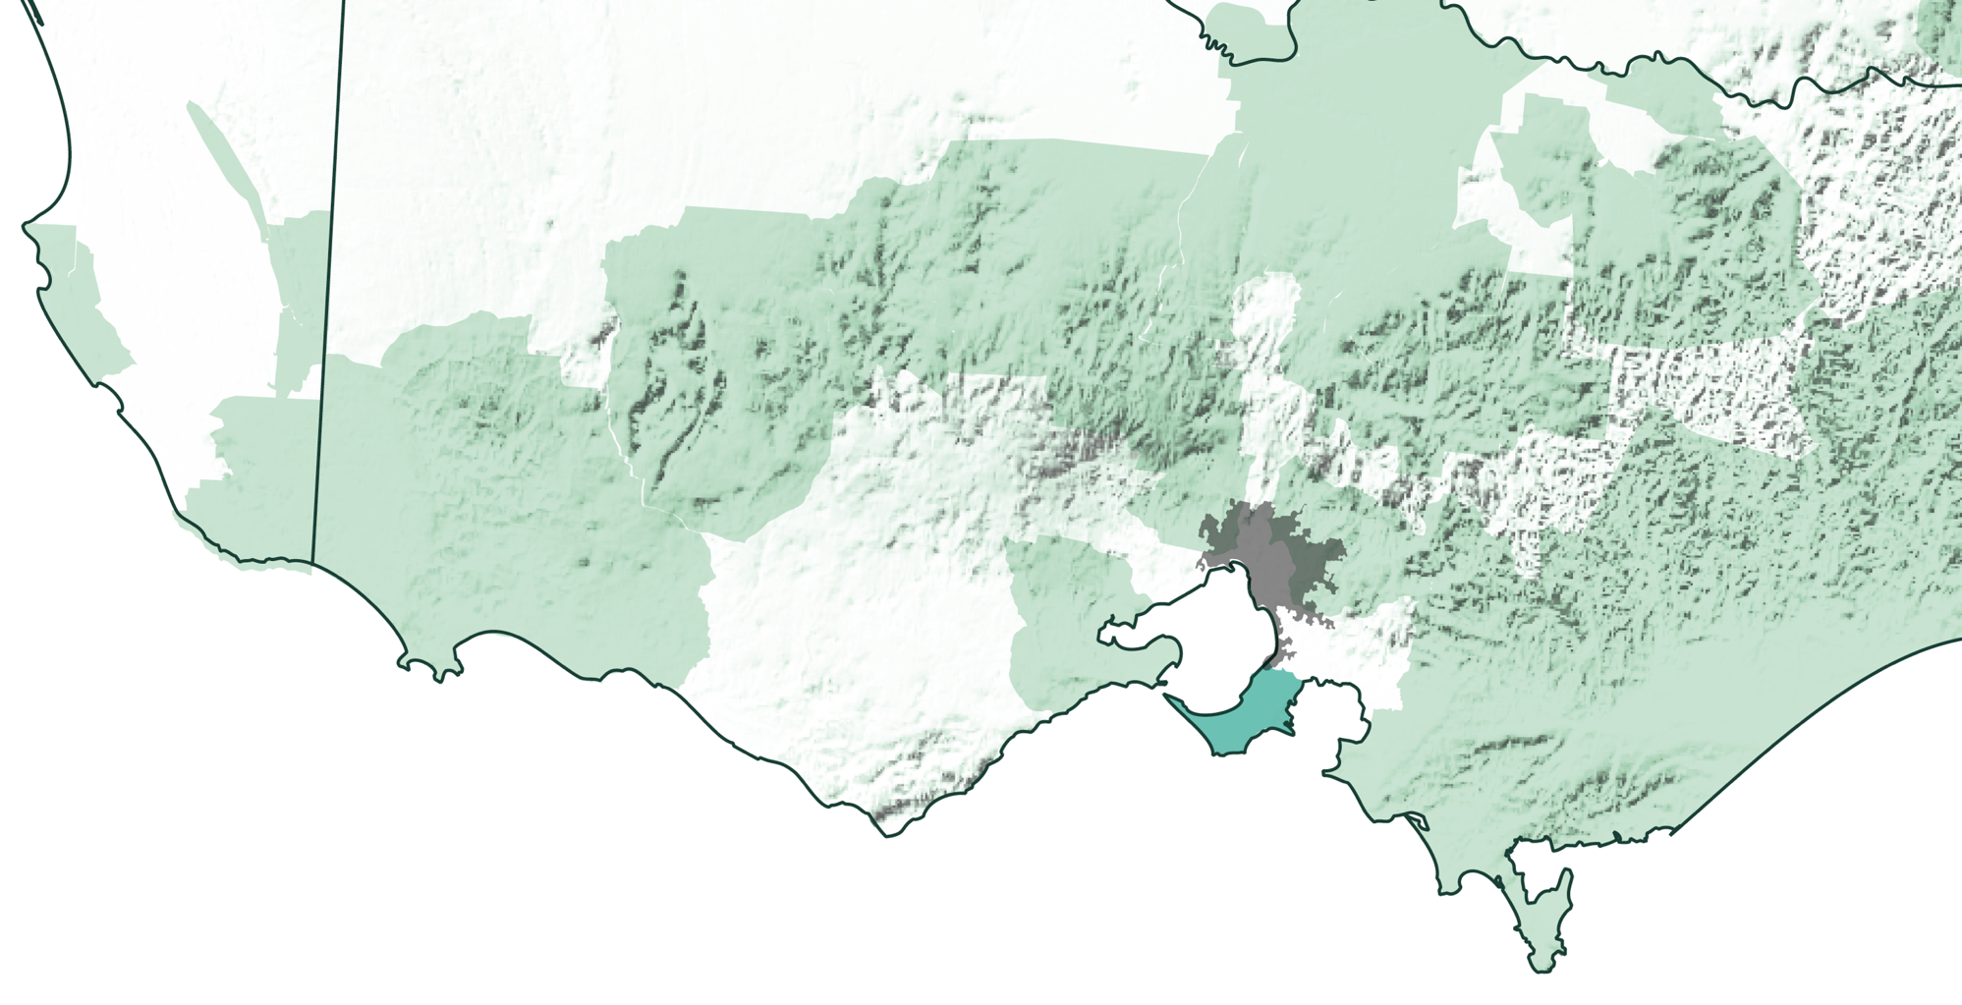
VICTORIA
Melbourne
MORNINGTON PENINSULA

Slide 7
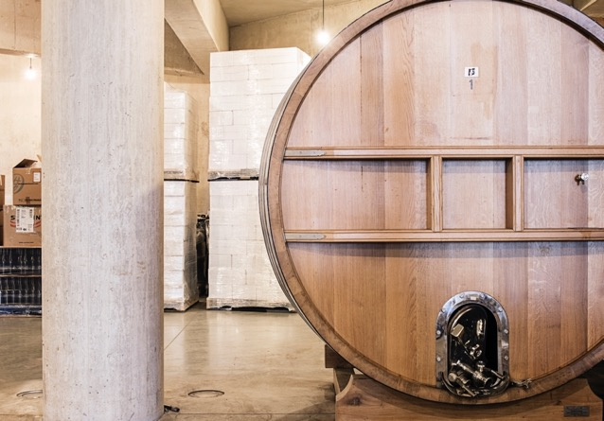
Late 1800s
HISTORY OF MORNINGTON PENINSULA
QUIET START, RAPID RISE
1970s
1980s
Grapes are first planted
as Victoria’s wine market flourishes during the gold rush. But an economic downturn and the popularity
of fortified wines cause its temporary demise.
A small band of winemakers establish a modern wine industry. Baillieu Myer plants at Elgee Park in Merricks North. Nat and Rosalie White build the first commercial winery at Main Ridge Estate. They have the council regulations changed to allow cellar-door sales.
The second wave of Peninsula producers make their mark. Moorooduc Estate and Paringa Estate are established and become leading wineries.

Slide 8
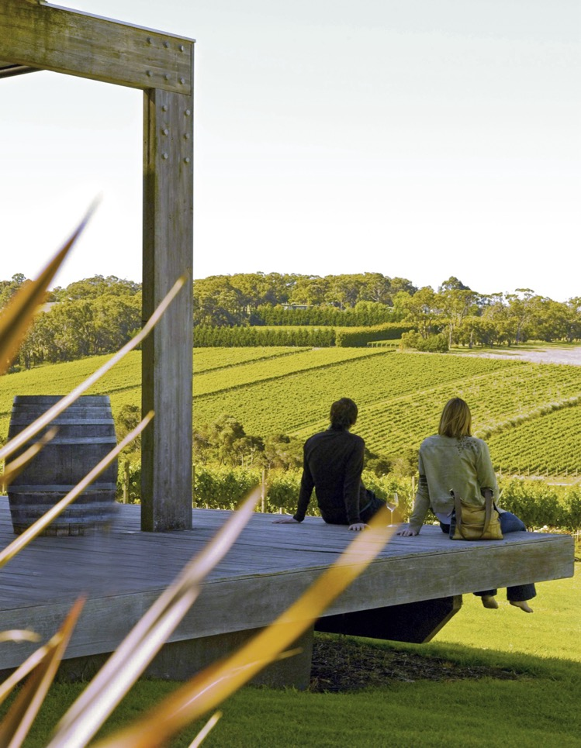
1990s
Peninsula winemakers refine the signature varieties of Pinot Noir and Chardonnay, and experiment with new varieties including Pinot Gris/Grigio. New vineyards continue to be planted.
1982
Today
The Mornington Peninsula Vignerons Association is incorporated.
The Mornington Peninsula is a premier cool-climate region creating world-class Pinot Noir and Chardonnay. Winemakers are spending more time in the vineyard and intervening less in the winery.

Slide 9
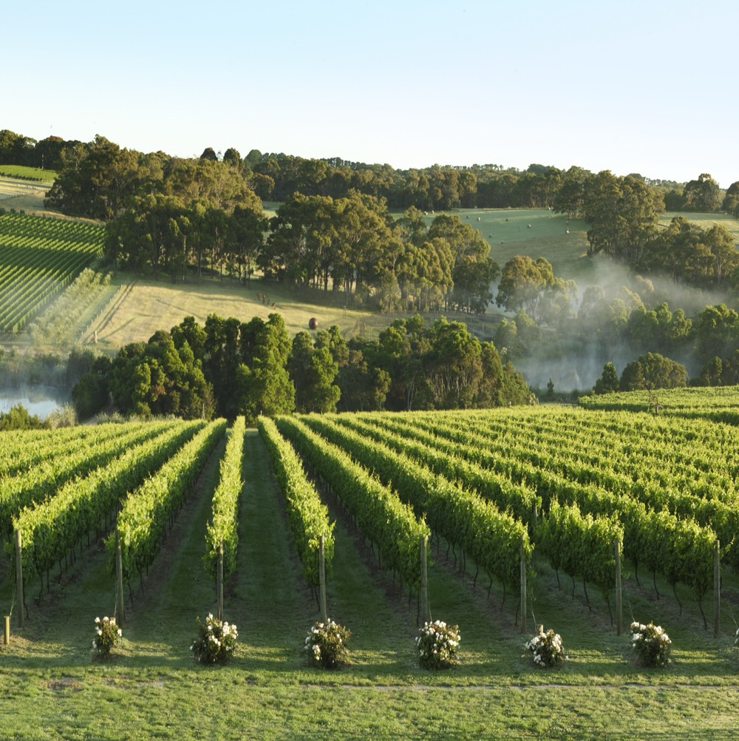
GEOGRAPHY, CLIMATE AND SOIL
A DIVERSE MARITIME REGION
Just over 70 kilometres south-east
of Melbourne
Surrounded by three bodies of water
Undulating landscape and fertile soils due to volcanic activity 60 million years ago
Incredibly varied microclimates

Slide 10
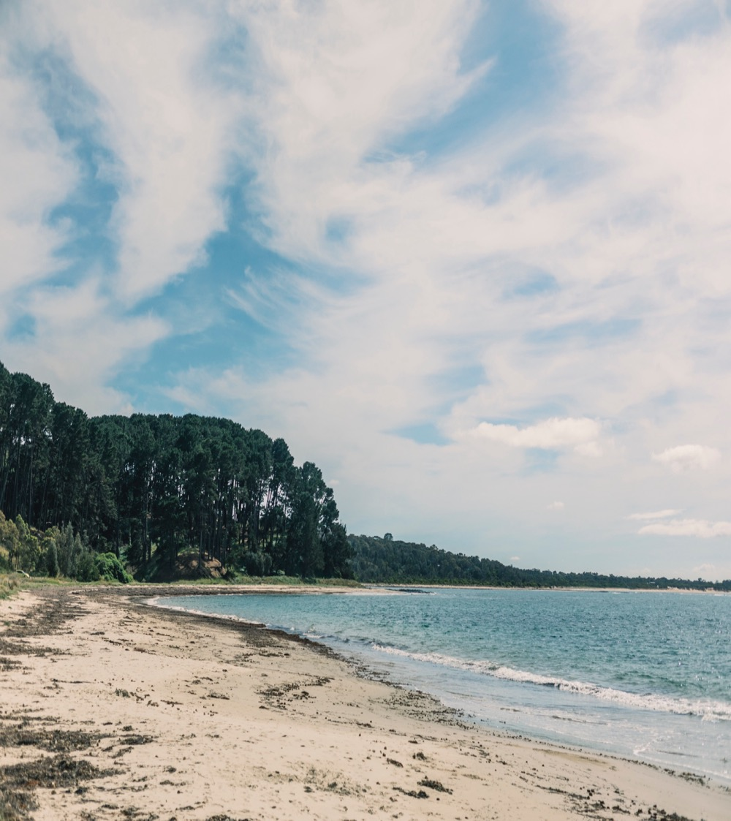
CLIMATE
ALTITUDE
TRUE MARITIME
VERY HIGH
1000m +
(>3,280ft +)
WITH AN ARRAY OF MESOCLIMATES AND MICROCLIMATES
HIGH
750–999m
(2,460–3,279ft)
MORNINGTON PENINSULA
10–260M (32–853FT)
MEDIUM
500–749m
(1,640–2,459ft)
LOW
0–499m
(0–1,639ft)

Slide 11
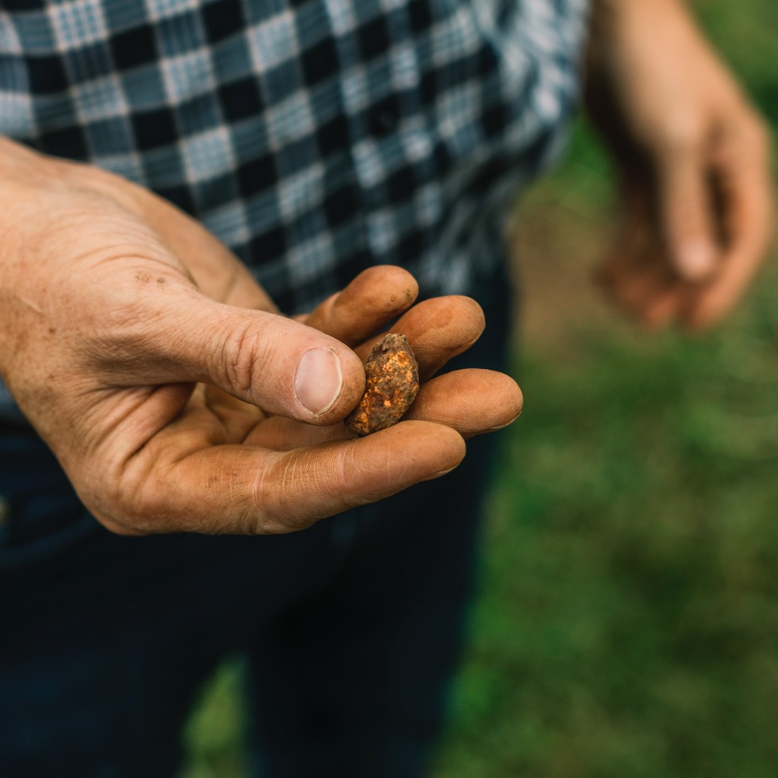
SOIL
Diverse soils ranging from yellow and brown soils over friable, well-drained clay to volcanic red clay to deep, fertile sandy soils in the northern area.

Slide 12
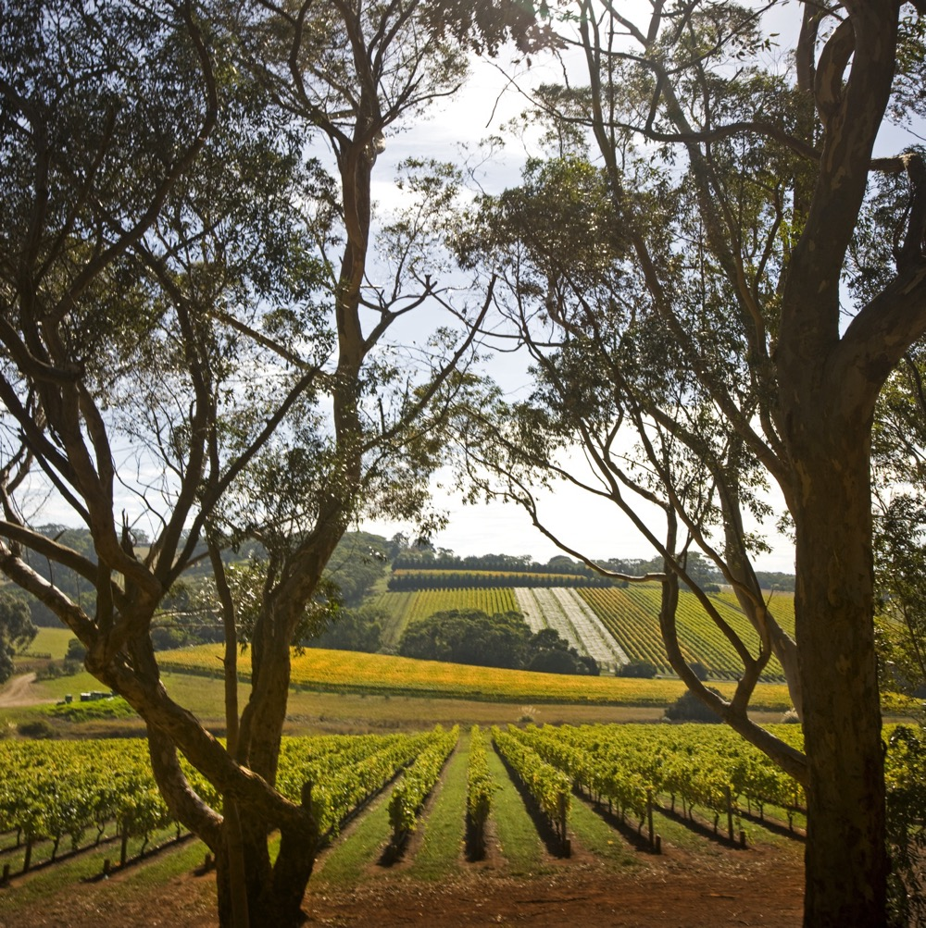
VITICULTURE IN MORNINGTON PENINSULA
A COMMUNITY OF PERFECTIONISTS
Small-scale vineyards, many family run
Pinot Noir accounts for almost half of the total annual crush
Viticulture practices influenced
by the demands of Pinot Noir
Harvest: late February to early April

Slide 13





WINEMAKING IN MORNINGTON PENINSULA
MASTERING MINIMAL INTERVENTION
MINIMAL INTERVENTION
WILD FERMENTATION
WHOLE BERRY FERMENTATION
ALTERNATIVE FERMENTATION/
MATURATION VESSELS
LARGER FORMAT OAK BARRELS

Slide 14
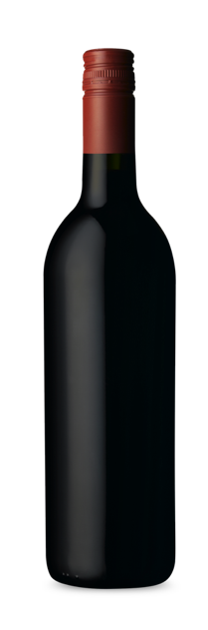
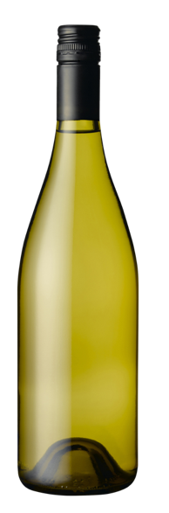
MORNINGTON PENINSULA
TOP 5 VARIETIES
CHARDONNAY
PINOT GRIGIO
SHIRAZ
SAUVIGNON BLANC
PINOT NOIR
PINOT NOIR
48%
CHARDONNAY
31%
PINOT GRIGIO
14%
SHIRAZ
3%
SAUVIGNON BLANC
2%

Slide 15

MORNINGTON PENINSULA
PINOT GRIS/
GRIGIO
HIGH CONCENTRATION OF PINOT GRIS/ GRIGIO IN MORNINGTON PENINSULA
MARITIME CLIMATE AND FERTILE SOILS
MAKE FOR IDEAL GROWING CONDITIONS
PINOT GRIGIO
TYPICAL FLAVOURS
Lime
Lemon
Green apple
White nectarine
Pear
Minerality

Slide 16
PINOT GRIS/GRIGIO characteristics
COLOUR
Pinot Gris/Grigio
Light
Medium
Full
BODY
Dry
Medium dry
Sweet
SWEETNESS
PINOT GRIGIO
Low
Medium
High
OAK
ACIDITY
8%
12.5% – 14.5%
17%
ALCOHOL

Slide 17
MORNINGTON PENINSULA
CHARDONNAY
WINES OF RESTRAINT
WITH GOOD AGEING POTENTIAL
WELL SUITED TO THE REGION’S COOL CONDITIONS
CHARDONNAY
TYPICAL PRIMARY
FLAVOURS
Melon
White peach
Citrus
Fig
Minerality
TYPICAL AGED
FLAVOURS
Stone fruits
Apple
Vanilla
Butter
AROUND
1/4
OF TOTAL
ANNUAL
CRUSH

Slide 18
CHARDONNAY characteristics
COLOUR
Chardonnay
Light
Medium
Full
BODY
Dry
Medium dry
Sweet
SWEETNESS
CHARDONNAY
Low
Medium
High
OAK
ACIDITY
8%
12.5% – 14.5%
17%
ALCOHOL

Slide 19

MORNINGTON PENINSULA
PINOT NOIR
STAR OF THE REGION
IMPRESSIVE RANGE OF EXPRESSIONS
PINOT NOIR
TYPICAL PRIMARY
FLAVOURS
Cherry
Strawberry
Plum Roses
Violets
Earth
TYPICAL AGED
FLAVOURS
Savoury
Earth
Cedar
Forest floor
OVER
1/2
OF TOTAL
ANNUAL
CRUSH

Slide 20
PINOT NOIR characteristics
COLOUR
Pinot Noir
Light
Medium
Full
BODY
Dry
Medium dry
Sweet
SWEETNESS
Low
Medium
High
PINOT NOIR
OAK
TANNIN
ACIDITY
8%
13% – 14%
17%
ALCOHOL

Slide 21
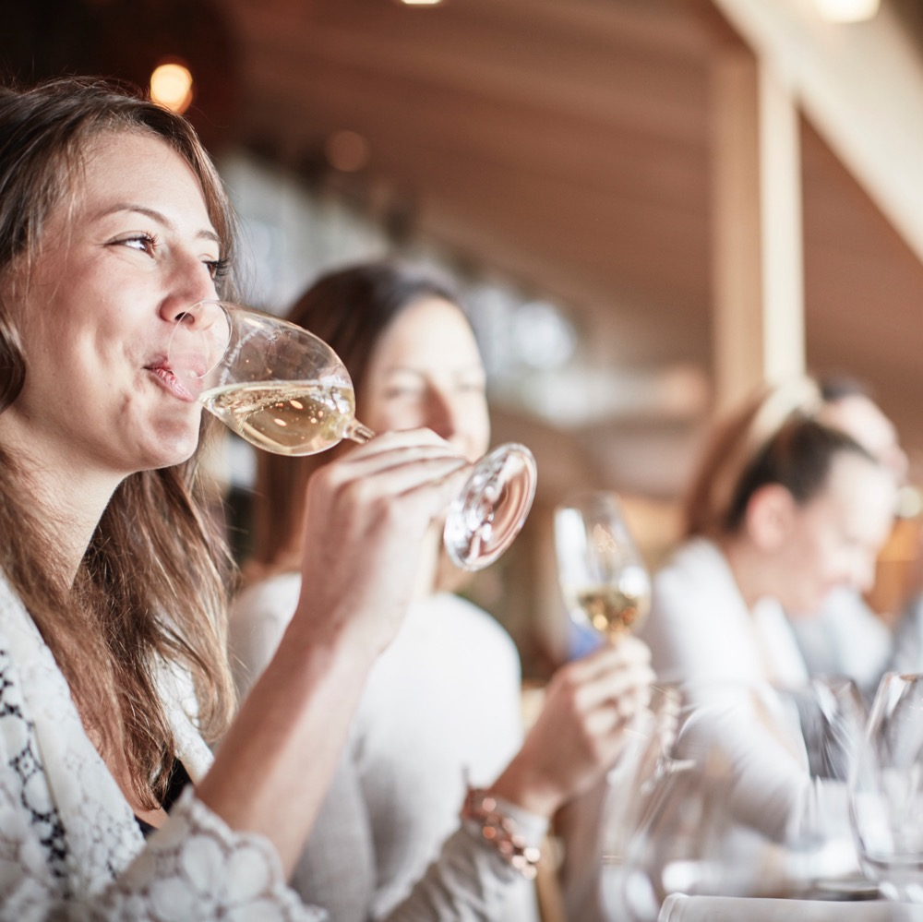
A REGION ON THE RISE WITH ELEGANT
COOL-CLIMATE WINES
MAKING WAVES IN AUSTRALIA’S WINE SCENE

Slide 22
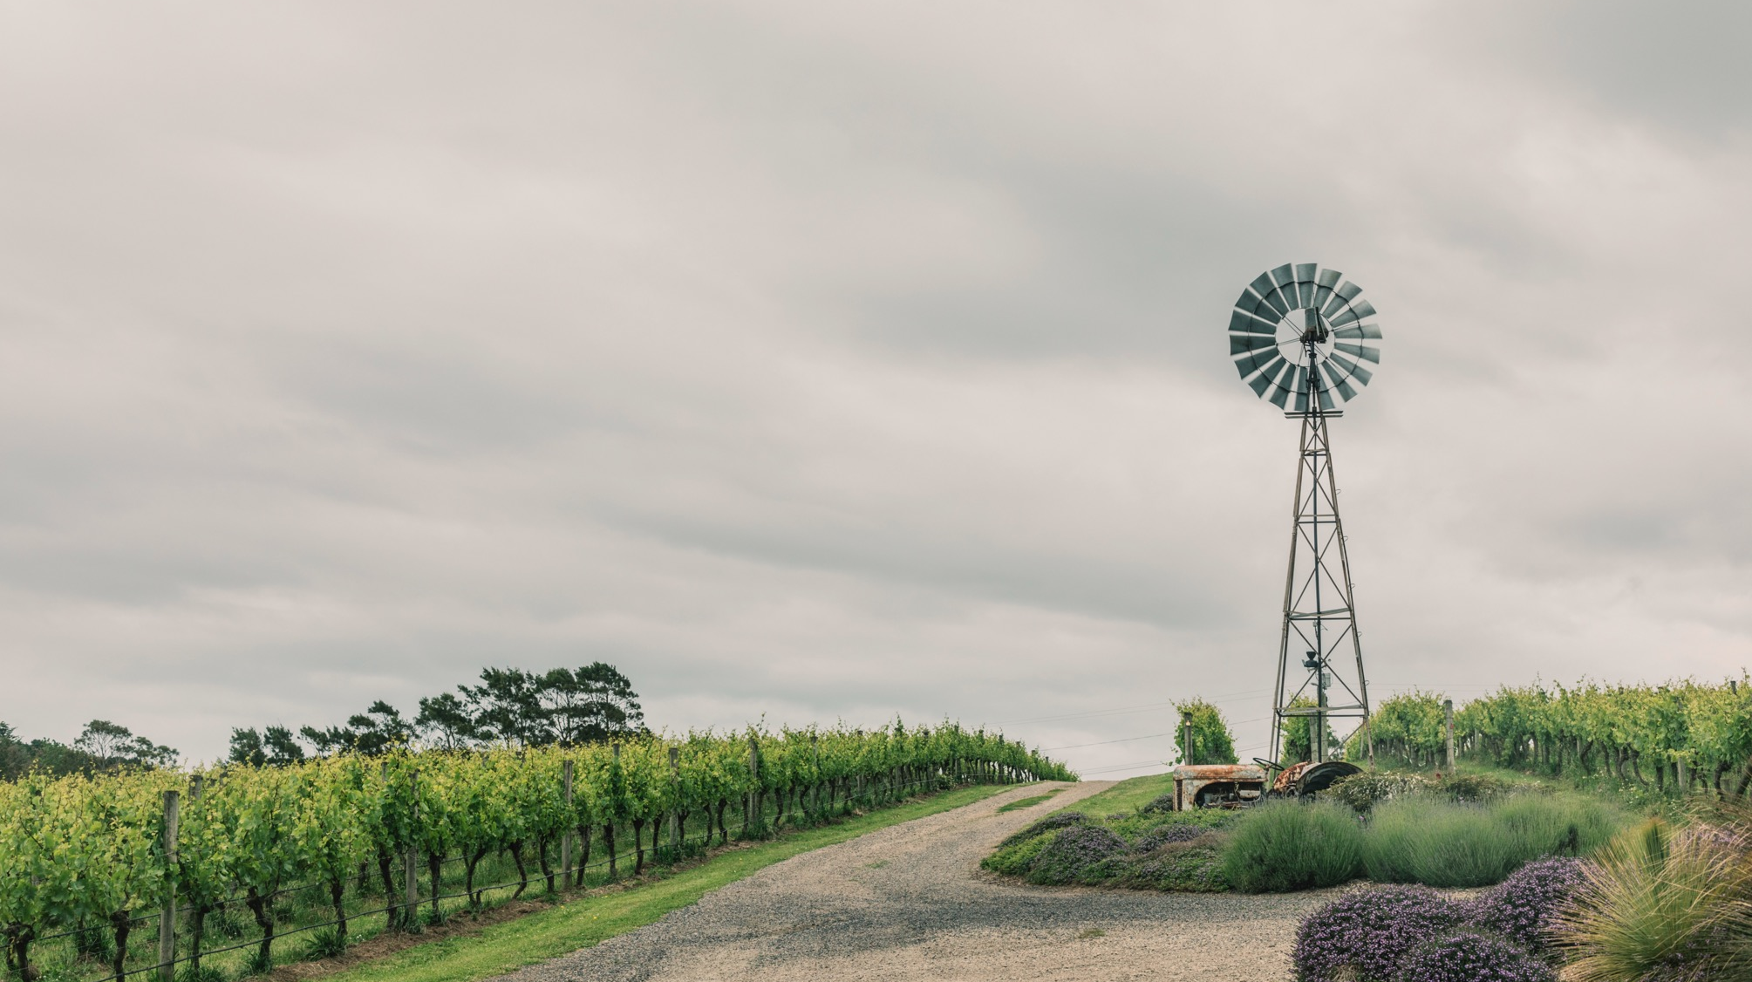
THANK YOU

